Slide 1
7 Algorithm design and problem-solving
Validation

Slide 2
Input validation
Input validation techniques
Type check
Range check
Presence check
Format check
Length check
Input validation means checking that data input by the user meets specific criteria/rules before processing.
Name:
*
Age:
DoB:
Code:
*
Agree with our Terms & Conditions:

Slide 3
Input validation
Input validation techniques
Type check
Range check
Presence check
Format check
Length check
Is the input of the correct data type? For example:
Integer
Real
String
Name:
*
Age:
DoB:
Code:
*
Agree with our Terms & Conditions:

Slide 4
Input validation
Is the input of the correct data type? For example:
Integer
Real
String
Pseudocode example
*
OUTPUT "Please enter your age"
REPEAT
INPUT Age
IF Age <> DIV(Age, 1)
THEN
OUTPUT "Age must be a whole number, try again."
ENDIF
UNTIL Age = DIV(Age, 1)
Name:
Age:
DoB:
Code:
*
Agree with our Terms & Conditions:

Slide 5
Input validation
Input validation techniques
Type check
Range check
Presence check
Format check
Length check
Is the input within the correct range? For example:
Between 1 and 10
Between A and Z
Name:
*
Age:
DoB:
Code:
*
Agree with our Terms & Conditions:

Slide 6
Input validation
Is the input within the correct range? For example:
Between 1 and 10
Between A and Z
Pseudocode example
*
OUTPUT "Please enter your age"
REPEAT
INPUT Age
IF (Age < 0) OR (Age > 100)
THEN
OUTPUT “Age must be between 0-100, try again."
ENDIF
UNTIL (Age => 0) AND (Age <= 100)
Name:
Age:
DoB:
Code:
*
Agree with our Terms & Conditions:

Slide 7
Input validation
Input validation techniques
Type check
Range check
Presence check
Format check
Length check
Has all required data been entered? For example:
Reject blank inputs
Name:
*
Age:
DoB:
Code:
*
Agree with our Terms & Conditions:

Slide 8
Input validation
Has all required data been entered? For example:
Reject blank inputs
Pseudocode example
Name:
*
OUTPUT "Enter your name"
REPEAT
INPUT Name
IF Name = ""
THEN
OUTPUT "You must enter your name to continue."
ENDIF
UNTIL Name <> ""
Age:
DoB:
Code:
*
Agree with our Terms & Conditions:

Slide 9

Input validation
Input validation techniques
Type check
Range check
Presence check
Format check
Length check
Is the input in the correct format? For example:
Date
Postcode
Name:
*
Age:
DoB:
Code:
*
Agree with our Terms & Conditions:
Covered in more detail in the following video:
8.1 The use of basic string handling

Slide 10
Input validation
Input validation techniques
Type check
Range check
Presence check
Format check
Length check
Does the input include the correct/minimum/maximum number of characters? For example:
Password
Car licence plate
National Insurance number
Name:
*
Age:
DoB:
Code:
*
Agree with our Terms & Conditions:

Slide 11
Input validation
Does the input include the correct/minimum/maximum number of characters? For example:
Password
Car licence plate
National Insurance number
Pseudocode example
Name:
*
OUTPUT "Enter your code"
REPEAT
INPUT Code
IF LENGTH(Code) <> 4
THEN
OUTPUT "You must supply a 4 letter code."
ENDIF
UNTIL LENGTH(Code) = 4
Age:
DoB:
Code:
*
Agree with our Terms & Conditions:

Slide 12
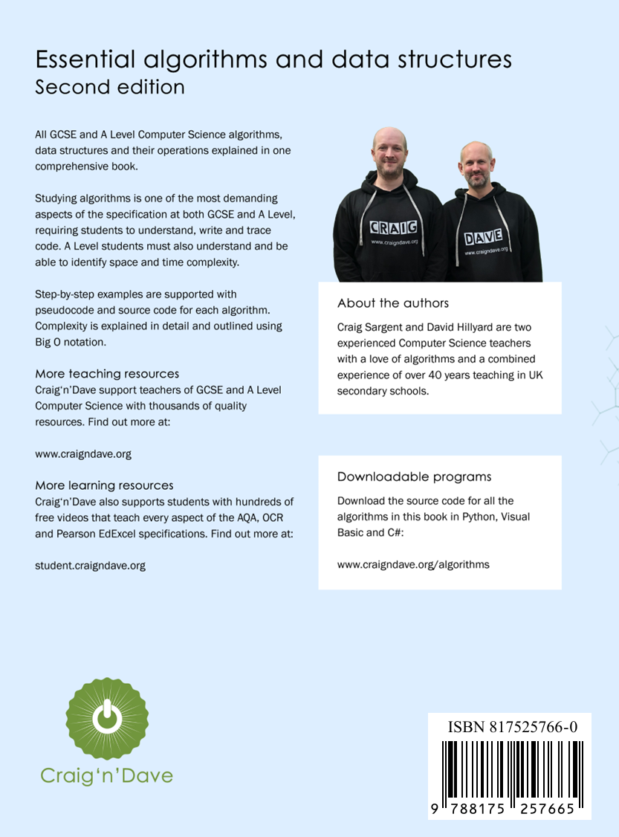
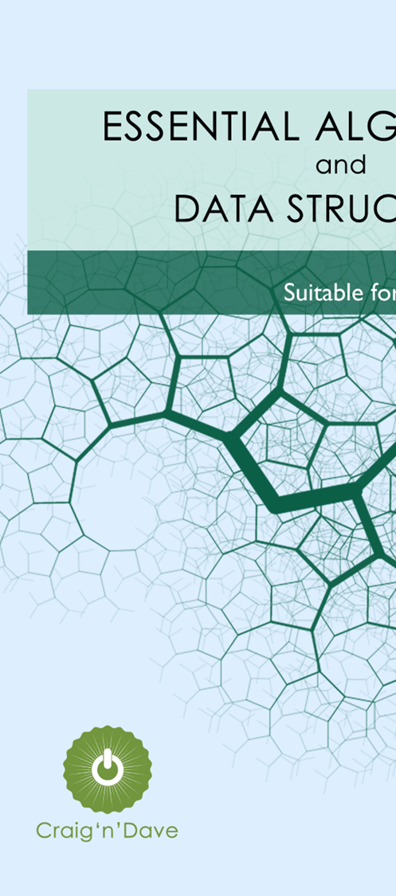
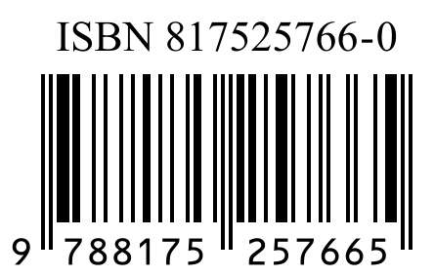
Check digits
A check digit is the last digit included in a code or other identification number. It is calculated from all the other digits in the code.
Check digits are commonly used with:
Barcodes
ISBN numbers
Vehicle Identification Numbers (VIN)
Check digit
Covered in more detail in the following video:
2.2 Check digits

Slide 13

Validation
Input validation means checking that data input by the user meets specific criteria/rules before processing:
Type check: The input is of the correct data type – e.g., integer, real, string.
Range check: The input is within a predetermined range – e.g., between 1 and 2.
Presence check: All required data has been entered – e.g., reject blank inputs.
Format check: The input is in the correct format – e.g., DD/MM/YYYY.
Length check: The input includes the correct/minimum/maximum number of characters – e.g., password.
By using input validation techniques, a programmer can:
Make their program more robust and user-friendly
Prevent further errors occurring later in the algorithm

Slide 14


